Slide 1
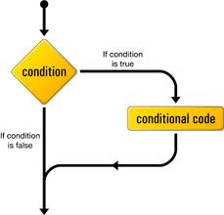

Control structures

Slide 2
Objectives
Types of control Structures
Simple if statement
if else statement

Slide 3
Control Structures
Types of Control Structures
Decision Making and branching (if, if-else, nested if, else-if ladder, switch statement)
Repetitive / Iterative (while, do-while and for loops)
Syntax
Control Flow

Slide 4
Execution Sequence?
/* vol.cpp - volume of cone*/
#include <iostream.h>
#include <math.h>
void main() {
float r, h, vol;
const float PI=3.14159;
cout<<"\nEnter value for r & h > ";
cin>>r>>h;
vol= (1.0/3)*PI*pow(r,2)*h;
cout<<"\nThe volume of cone is: "<< vol;
}
Syntax
Control Flow
Execution Sequence ? SEQUENTIAL
Notes:
C program is a set of statements, which are normally executed sequentially in the order in which they
appear. This happens when no options or no repetitions of certain calculations are necessary. However, in
practice we have a number of situations where we may have to change the order of execution of statements
based on certain conditions (Selection Construct), or repeat a group of statements until specified
conditions are met (Iteration Construct).

Slide 5
Control Structures
A control structure refers to the way in which the Programmer specifies the order of executing the statements
The following approaches can be chosen depending on the problem statement:
Sequential (Serial)
In a Sequential approach, all the statements are executed in the same order as it is written.
Selectional (Decision Making and Branching)
In a Selectional approach, based on some conditions, different set of statements are executed.
Iterational (Repetition)
In an Iterational approach certain statements are executed repeatedly.
Syntax
Control Flow
Notes:
Control structures are used to alter the flow of execution of the program. Why do we need to alter the program flow ? The reason is “decision making“! In life, we may be given with a set of option like doing “Electronics” or “Computer science”. We do make a decision by analyzing certain conditions (like our personal interest, scope of job opportunities etc). With the decision we make, we alter the flow of our life’s direction. This is exactly what happens in a C++ program. We use control structures to make decisions and alter the direction of program flow in one or the other path(s) available.

Slide 6
DECISION MAKING AND BRANCHING
SELECTIONAL
C++ program (structured ones) is a set of statements which are normally executed sequentially in the order in which written.
But in practice it is required to change the order based on certain conditions , or repeat a group of statements until certain specified conditions are met. This requires decision making.
C++ decision making and branching statements are:
1. if Statement
2. switch statement
Syntax
Control Flow

Slide 7
if statement
Used to control the flow of execution of statements.
It’s a Two-way decision statement, used in conjunction
with an expression.
It takes the form: if(test expression)
It allows to evaluate the expression first and then, depending on the value; true or false, it transfer the control to a particular statement.
i.e. Two-way branching
as shown in fig. →
Syntax
Control Flow
Entry
Test
Expression
?
False
True

Slide 8
Different forms of if statement
1. Simple if statement.
2. if…else statement.
3. Nested if…else statement.
4. else if ladder.
Syntax
Control Flow

Slide 9
Simple if Statement
General form of the simplest if statement:
if (test Expression)
{
statement-block;
}
statement_x;
Syntax
Control Flow

Slide 10
if Statement- explanation
(test Expression) is evaluated.
If TRUE (non-zero) the statement (or a block of statements) is executed.
If FALSE (zero) the next statement following the if
statement block is executed.
So, during the execution, based on some condition, some
code will not be executed (skipped).
For example: bonus = 0;
if (hours > 70)
bonus = 10000;
salary= salary + bonus;
Syntax
Control Flow

Slide 11
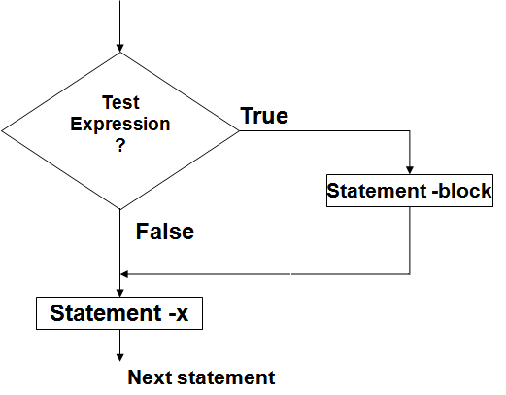
Flow chart of simple if control
Entry
Syntax
Control Flow

Slide 12
Given two integer numbers, find out the larger among them.
#include <iostream.h>
void main()
{
float fx, fy;
cout <<“ input two numbers\n”;
cin>>fx>>fy;
float big = fx;
if (fy>big)
big = fy;
cout<<big;
}
Syntax
Control Flow

Slide 13
Find out whether a number is even or odd.
#include <iostream.h>
void main()
{
int ix;
cout<<“input an integer\n”;
cin>>ix;
if ((ix % 2) == 0)
cout<<“it is even number\n”;
if ((ix%2) == 1)
cout<<“it is odd number\n”;
}
Syntax
Control Flow

Slide 14
To accept 3 sides, to check the possibility by half perimeter concept and to find the area of a triangle.
#include <iostream.h>
void main()
{
float s, side_a, side_b, side_c, area;
cout<<"Enter the sides of a triangle:”;
cin>>side_a>>side_b>>side_c;
s=(side_a+side_b+side_c)/2; // half perimeter
if(s<=side_a || s<=side_b || s<=side_c)
/* if sum of two sides less than third side */
{
cout<<"Triangle is not possible with the given sides."; exit(0);
}
area=sqrt(s*(s-side_a)*(s-side_b)*(s-side_c));
cout<<“ \nArea of the triangle =“<<area;
}
Syntax
Control Flow

Slide 15
Problem
Draw the flowchart which reads four values a, b, c
and d from the terminal (keyboard) and evaluates
the ratio (a + b) to (c – d), if and only if c-d is greater
than 0, and print the result.
i.e. if c-d >0 [condition]
then compute (a + b)/(c - d);
Syntax
Control Flow

Slide 16
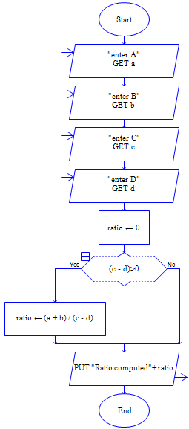
Solution
Flow chart - ratio
Syntax
Control Flow

Slide 17

If else statement
Explanation:
1.The (expression) is evaluated.
2.If it evaluates to non-zero (TRUE), statement_1 is executed, otherwise, if it evaluates to zero (FALSE), statement_2 is executed.
3.They are mutually exclusive, meaning, either statement_1 is executed or statement_2, but not both.
4.The statements_ 1 and statements_ 2 can take the form of block and must be put in curly braces.
Example: if(job_code == 1)
rate = 7.00;
else
rate = 10.00;
cout<<“ rate is ”<<rate;
Syntax
Control Flow

Slide 18
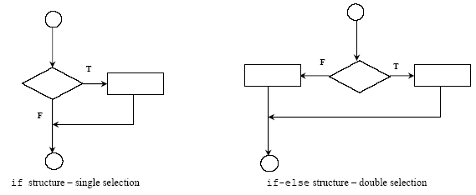
Flow of control
Syntax

Slide 19
WAP to find largest of 2 numbers
#include<iostream.h>
#include<conio.h>
void main()
{
clrscr();
float fa, fb;
cout<<"enter 2 numbers"<<endl;
cin>>fa>>fb;
cout<<endl;
if(fa > fb)
cout<<"large is "<<fa;
else
cout<<"large is "<<fb;
}
Syntax
Control Flow
if(fa > fb)
cout<<"large is "<<fa;
else
cout<<"large is "<<fb;

Slide 20
WAP to check whether a number is even or not
#include<iostream.h>
#include<conio.h>
void main()
{
int inum;
clrscr();
cout<<"enter a number ";
cin>> inum;
if (inum%2==0)
cout<<"the number is even";
else
cout<<"the number is odd";
getch();
}
Syntax
Control Flow
if (inum%2==0)
cout<<"the number is even";
else
cout<<"the number is odd";

Slide 21
Finds the average marks scored by a student and find whether he has failed or passed.
#include <iostream.h>
void main ()
{
float fMark1, fMark2, fMark3,fSum,fAvg;
cout<<"Enter the marks scored by the student in 3 subjects\n";
cin>>fMark1>>fMark2>>fMark3;
/* calculating the average marks */
fSum=fMark1+fMark2+fMark3;
fAvg=fSum/3;
/* compare the average with 70 and decide whether student has passed or failed */
if ( fAvg >= 65.0)
cout<<"PASS";
else
cout<<"FAIL";
}
Syntax
Control Flow
if ( fAvg >= 70.0)
cout<<"PASS";
else
cout<<"FAIL";

Slide 22
Problem
Draw the flowchart which reads four values a, b,
c and d from the terminal (keyboard) and
evaluates the ratio (a + b) to (c – d), if and only if
c-d is greater than 0, and print the result.
i.e. if c-d >0 [condition]
then compute (a + b)/(c - d);
else
“c-d value is less than Zero” ;
Syntax
Control Flow

Slide 23
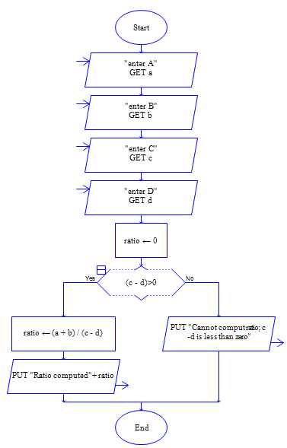
Solution
Flow chart - ratio
Syntax
Control Flow

Slide 24
Syntax
Simple if statement:
if (test Expression)
{
statement-block;
}
statement_x;
if else statement:
if ( test Expression)
statement1;
else
statement2;
next_statements;
Control Flow
if ( test Expression) {
statement-block1;
}
else {
statement-block2;
}
next_statements;

Slide 25
Summary
Types of control structures
Simple if statement
if else statement
Syntax
Control Flow
Do It Yourself

